Slide 1
Ion Channels

Slide 2
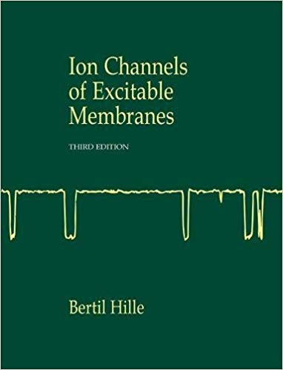

Slide 3
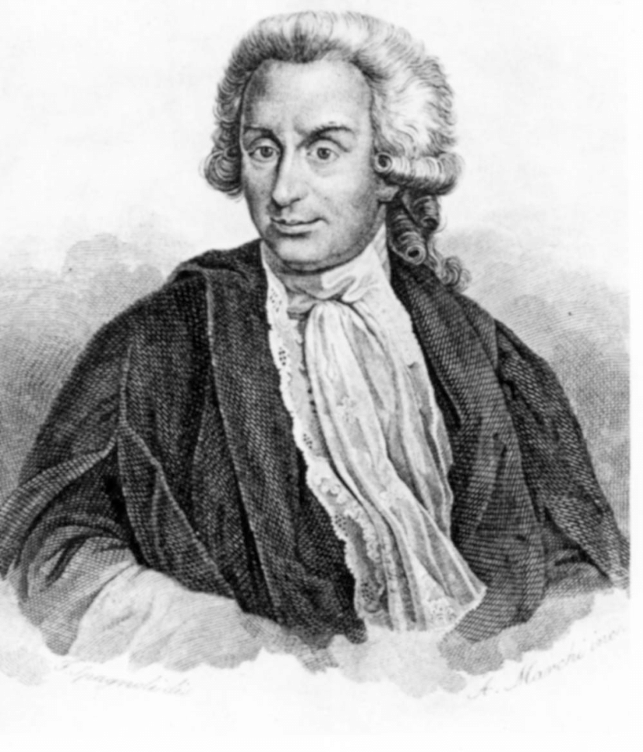
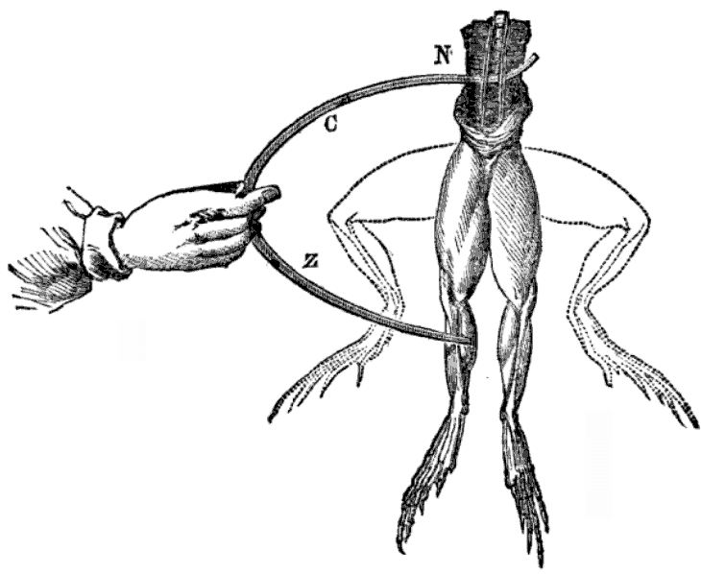
Question: what is the nature of ‘animal spirits’ ?
Luigi Galvani

Slide 4
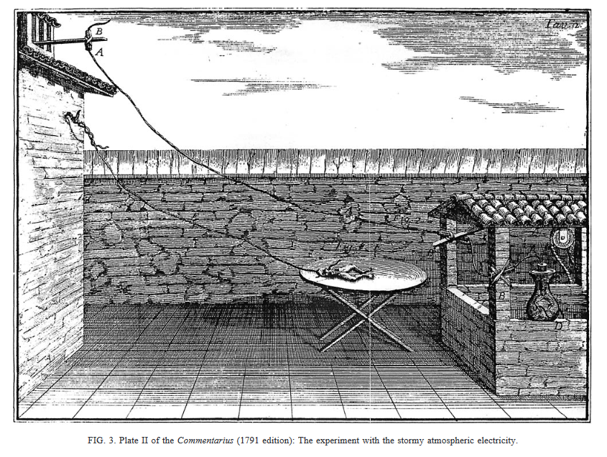

Slide 5
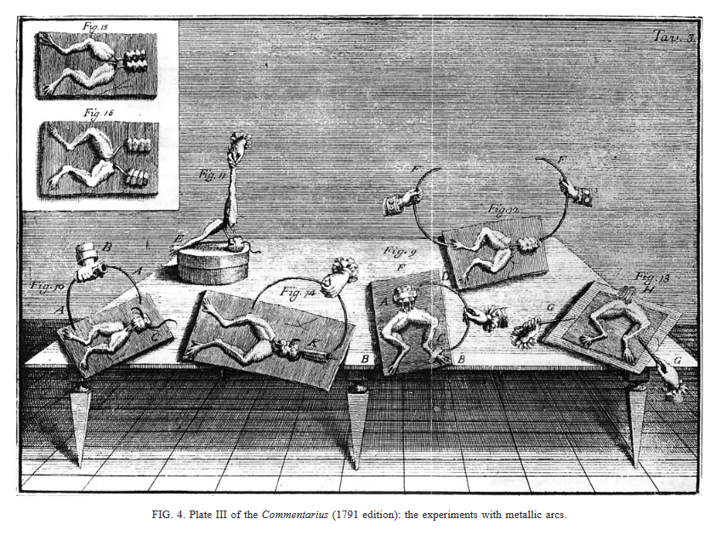
Conclusion: there is bio-electricity, electrical forces that are intrinsic to the animal (animal electricity)

Slide 6
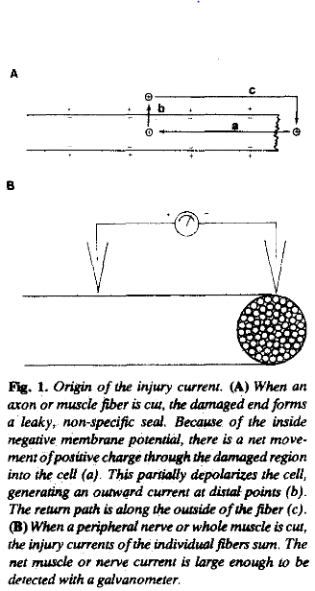
Question: what is the electrical potential signal of the “excitatory process” in muscle and nerves?
Julius Bernstein
Injury current
(Carlo Matteucci)

Slide 7
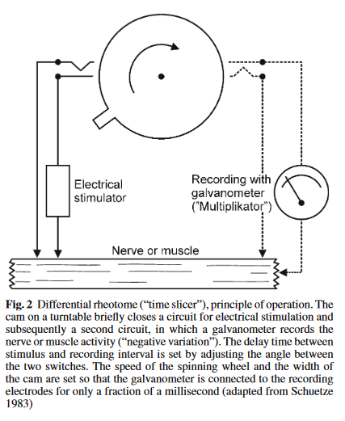
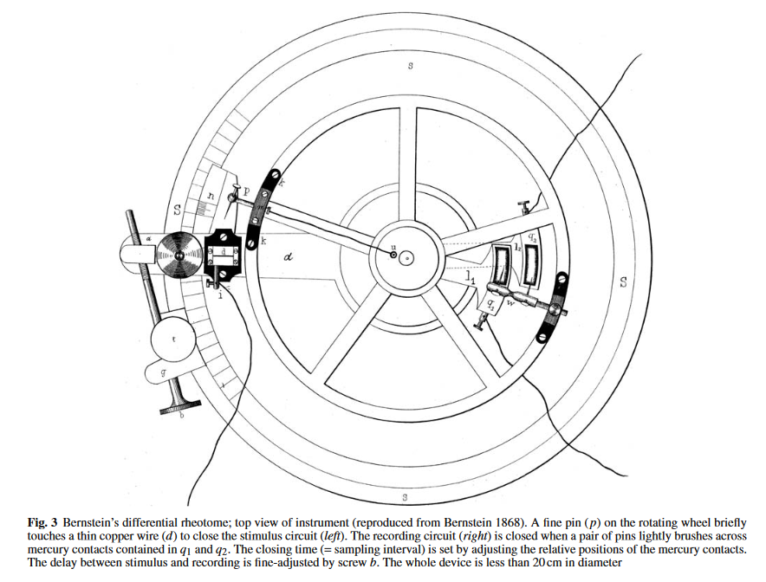

Slide 8
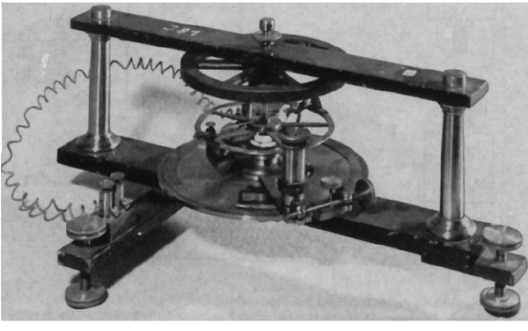
Conclusion: a fast voltage change that is larger then a “resting” potential

Slide 9
Question: what is the physico-chemical nature of bioelectric events?

Slide 10
“Let us imagine that these electrolytes diffuse unhindered from the axial cross section of the fibrils into the surrounding fluid, while they are prevented from diffusing through the longitudinal section by an intact plasmalemma which is impermeable to one kind of ion such as the anion (PO−4 etc.) to a greater or lesser degree. Then an electrical double layer would emerge at the surface of the fibril, with negative charges towards the inside and positive charges towards the outside. Indeed, this electrical double layer must also exist in the undamaged fiber, but would become apparent only in response to lesion or stimulation (negative variation). This assumption would imply a theory of pre-existence. As the semipermeable membrane plays an essential role in this theory, I will succinctly call it ‘Membrane Theory’.”
Conclusion: ions separated by a membrane with selective permeability, which breaks down during impulses

Slide 11
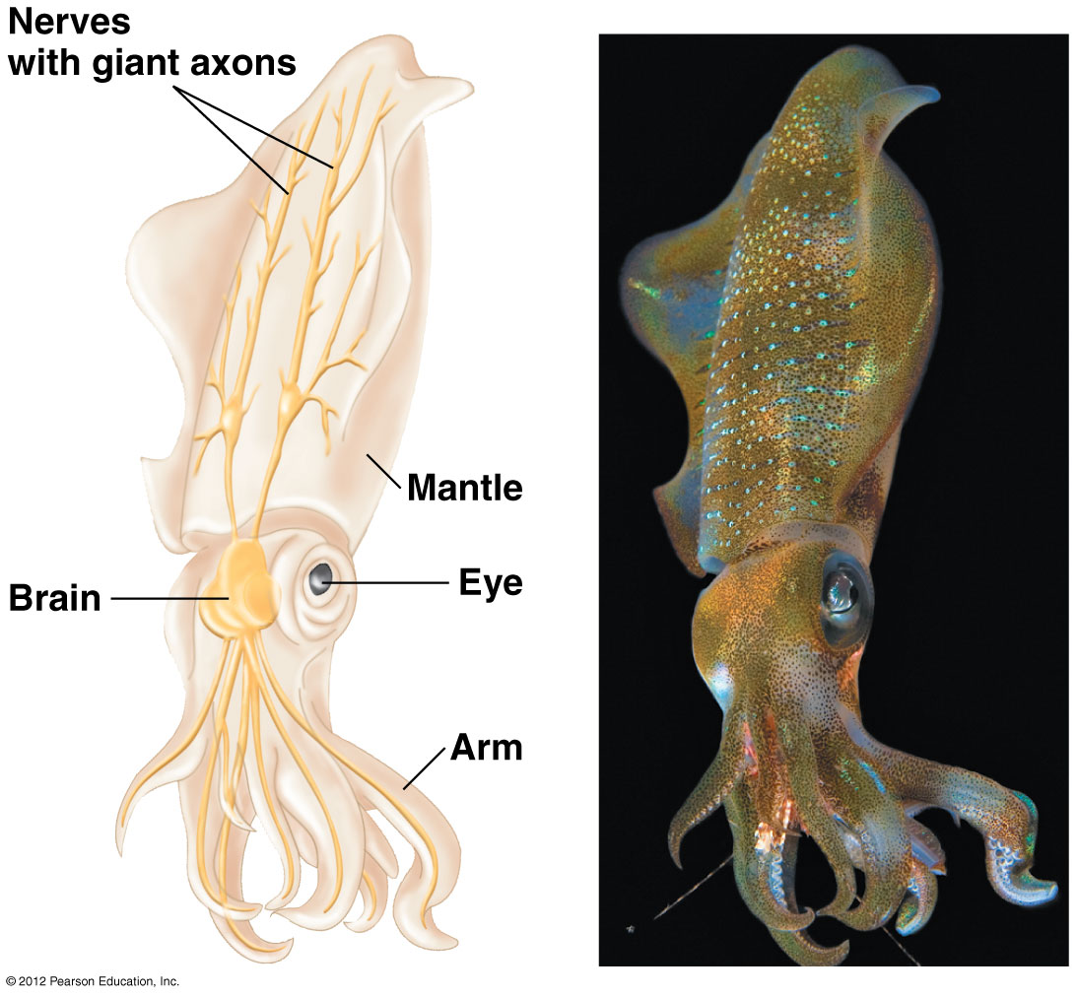
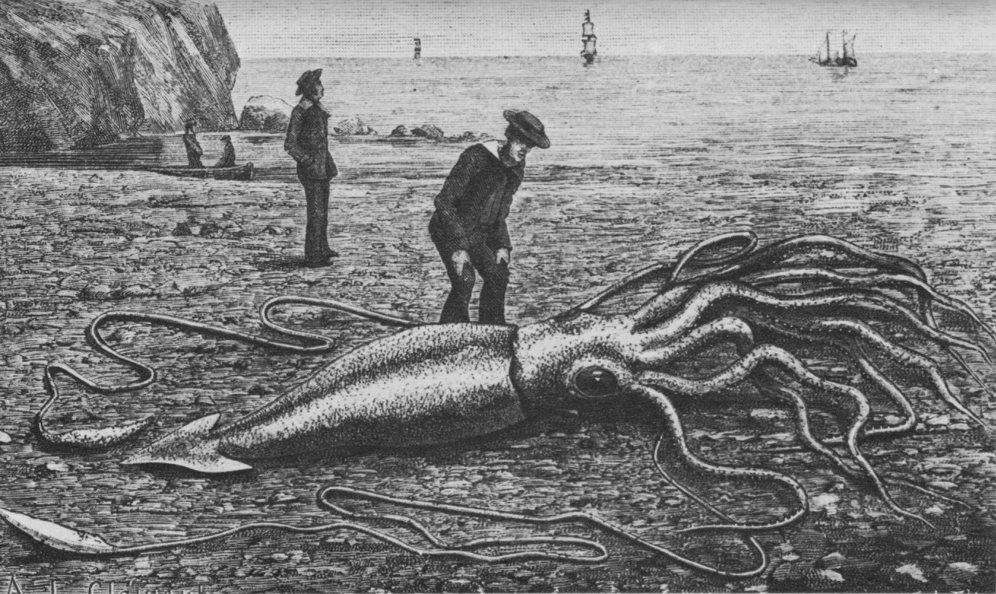
Question: is the membrane breakdown hypothesis correct?

Slide 12
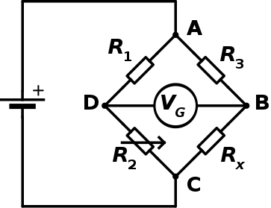
Kacy Cole and Howard Curtis, 1939
Wheatstone bridge

Slide 13
Conclusion: Membrane breakdown hypothesis holds

Slide 14
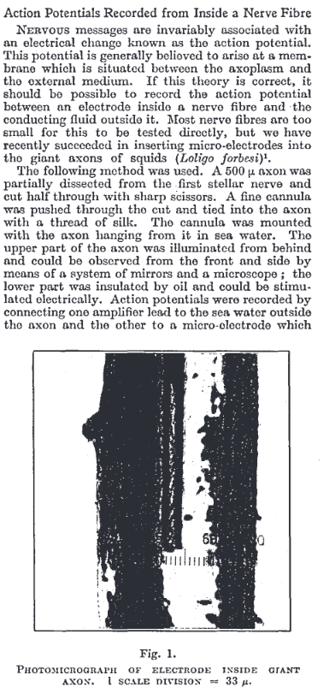
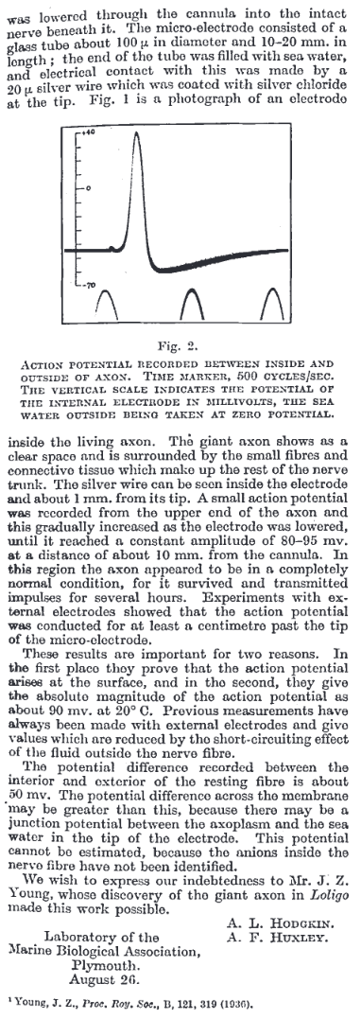
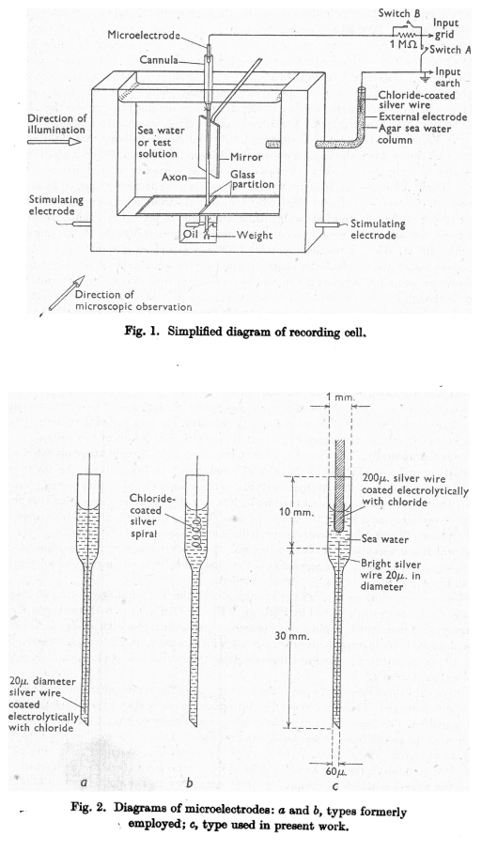
Question: is the membrane breakdown hypothesis correct?
Alan Hodgkin and Andrew Huxley, 1939

Slide 15
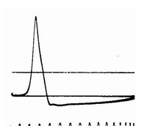
Alan Hodgkin and Andrew Huxley, 1939
Kacy Cole and Howard Curtis, 1939

Slide 16
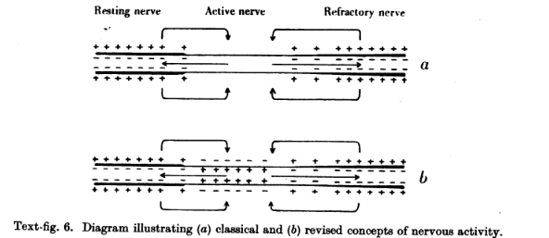
Conclusion: Membrane breakdown hypothesis needs revising

Slide 17
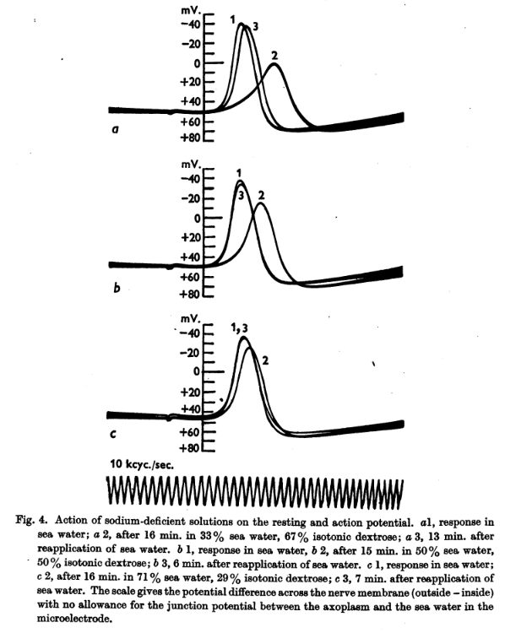
Question: is sodium responsible for the overshoot of the action potential?
Conclusion: Yes

Slide 18
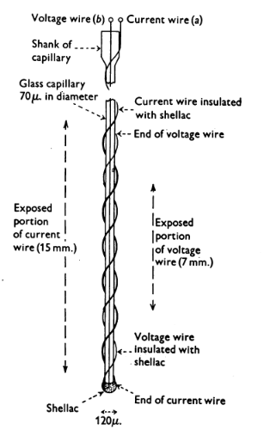
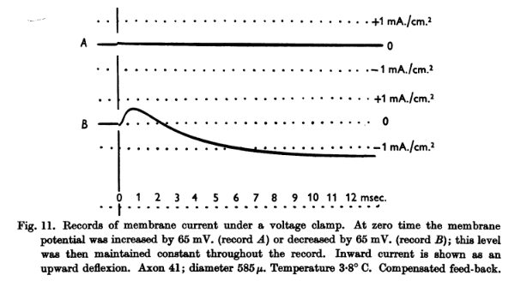
Question: what are the ionic currents that generate the action potential?

Slide 19
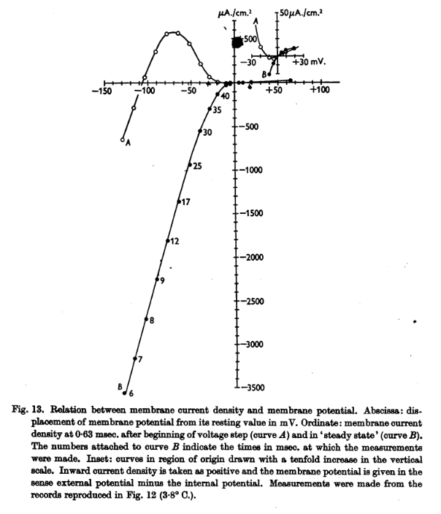
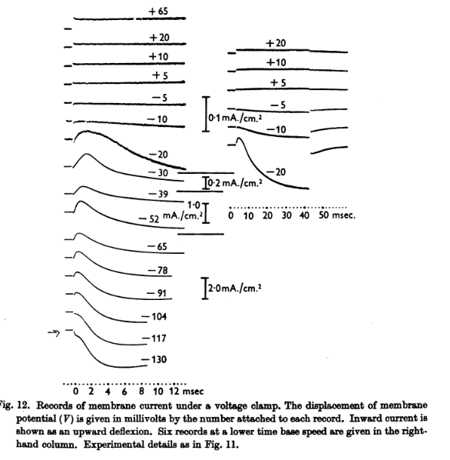

Slide 20
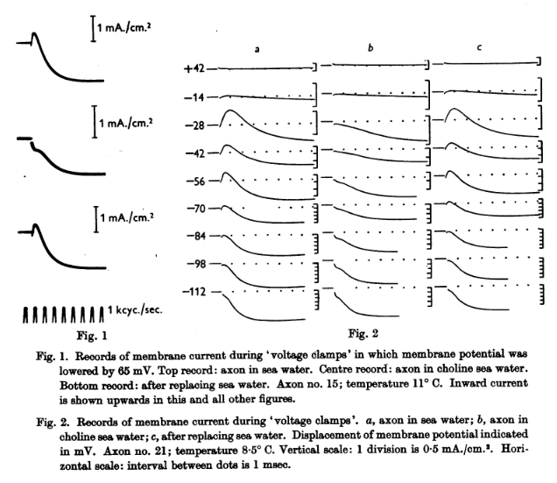
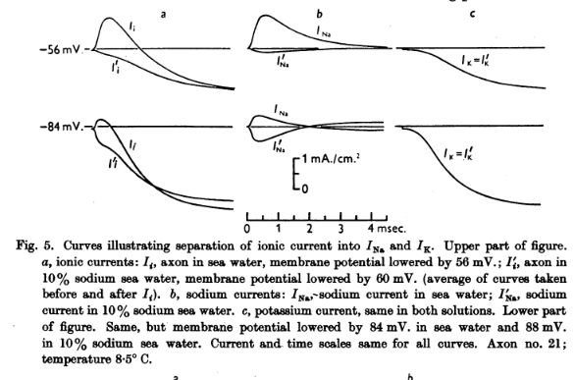

Slide 21
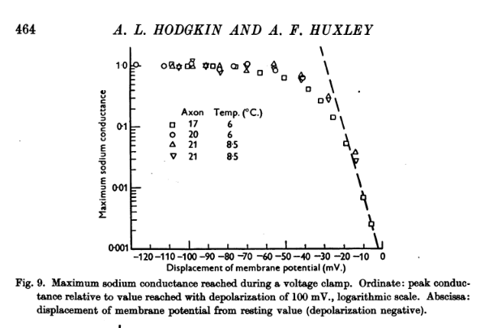
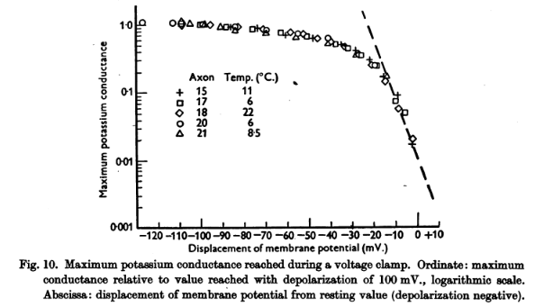

Slide 22
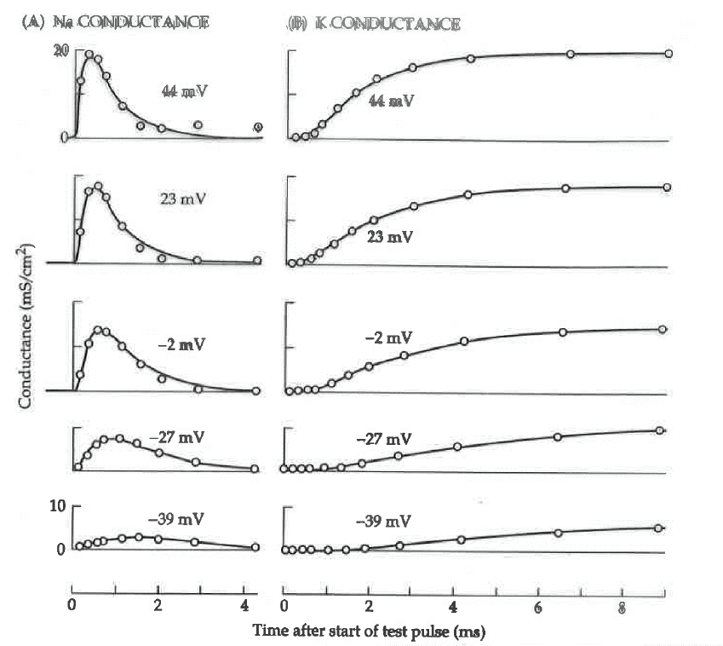
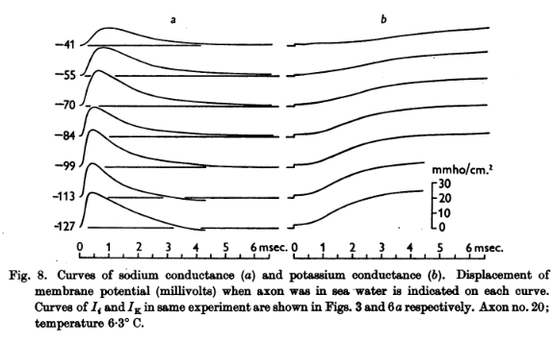
Conclusion: Fast activating/inactivating sodium current and slow activating/non-inactivating potassium current

Slide 23
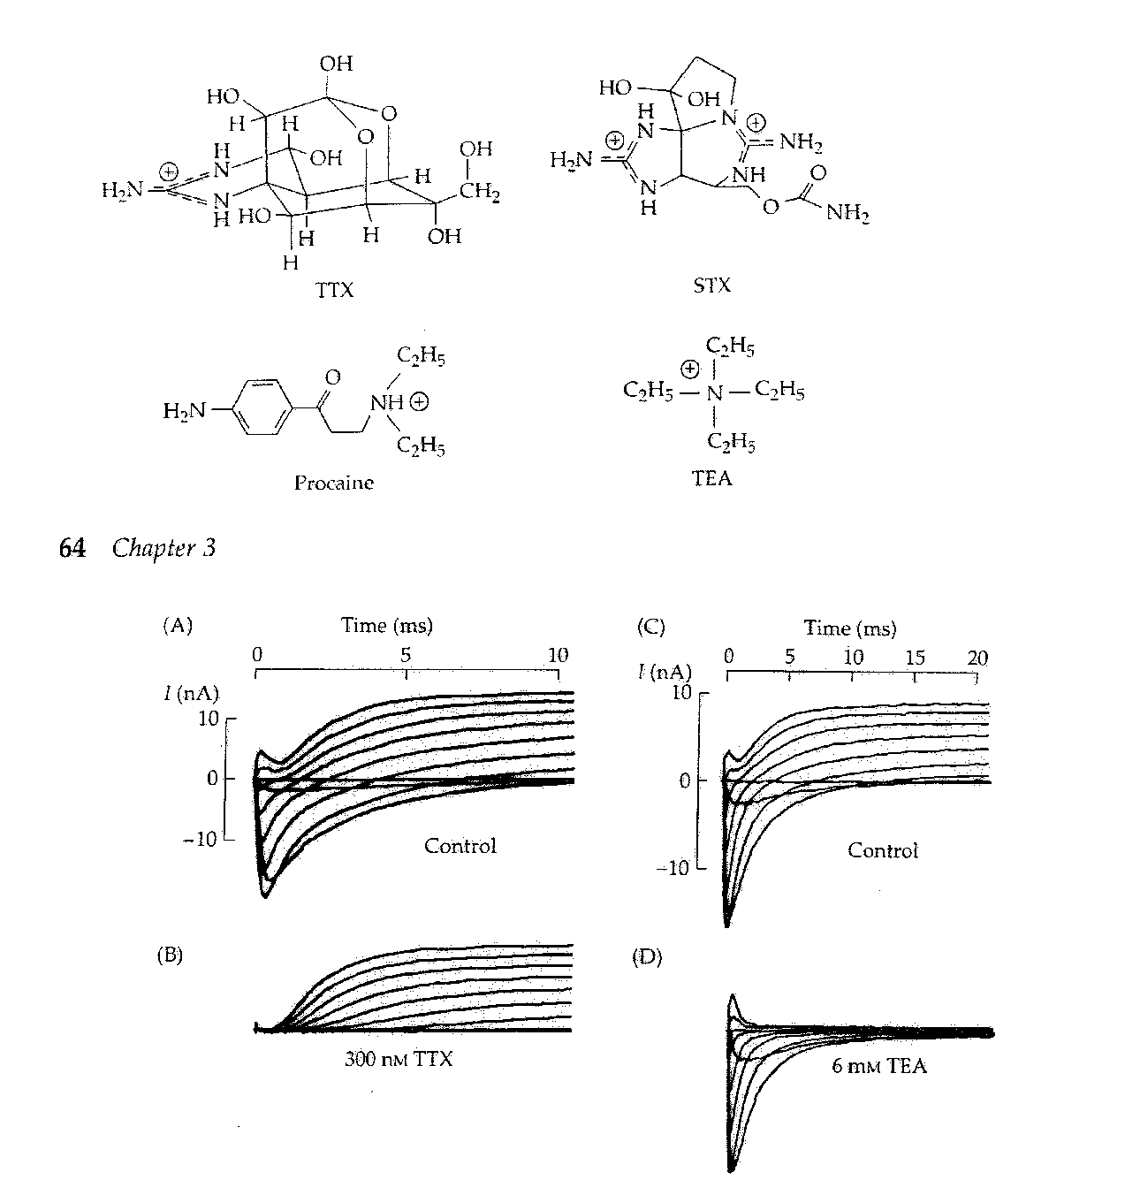
Question: how do ions cross membranes?
(Narahashi 1964)
(Armstrong & Binstock 1965)

Slide 24
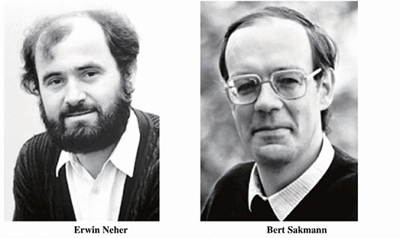

Slide 25
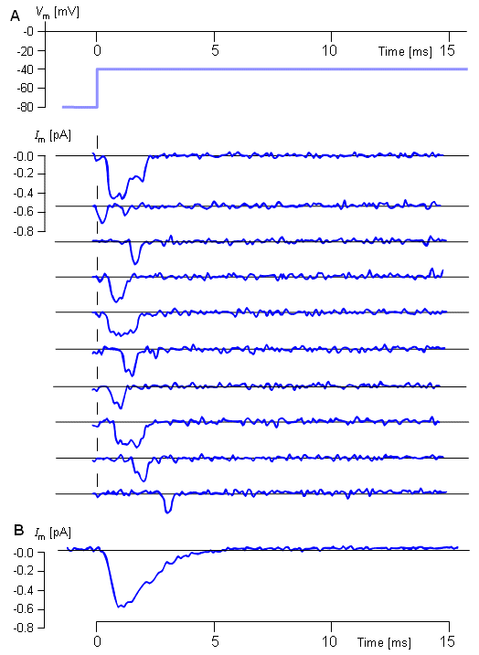
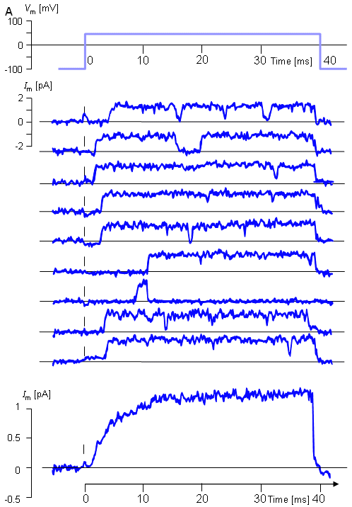
Conclusion: It is most likely a pore

Slide 26
Question: How can a pore be selective?

Slide 28
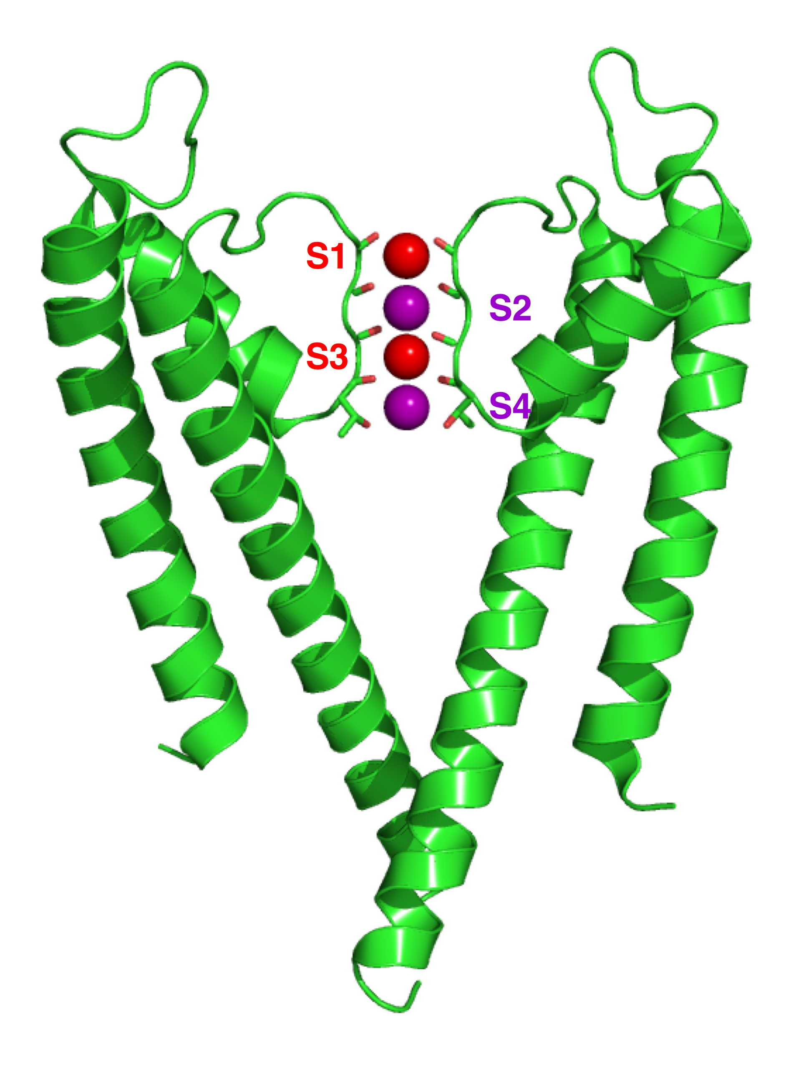
Kcsa channel

Slide 30
Conclusion: It’s a pore, and the energy landscape determines selectivity

Slide 31
Question: How is a channel gated by voltage?
(Keynes & Riojas 1974)
(Armstrong & Bezanilla 1973)

Slide 32
*
Shaker
Kv1.2
Kv2.1
Kv3.1
Kv4.1

Slide 33
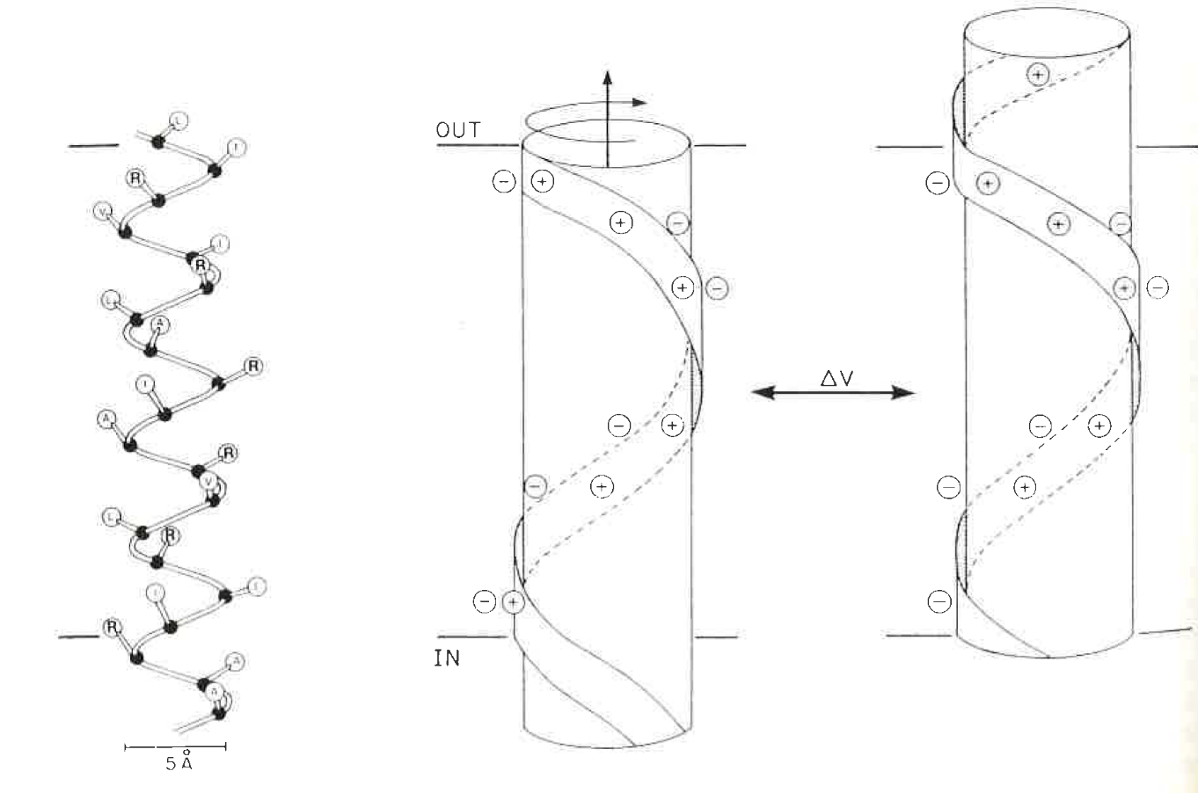
Helical screw model of S4 movement
(Catterall 1986, Guy 1986)

Slide 34
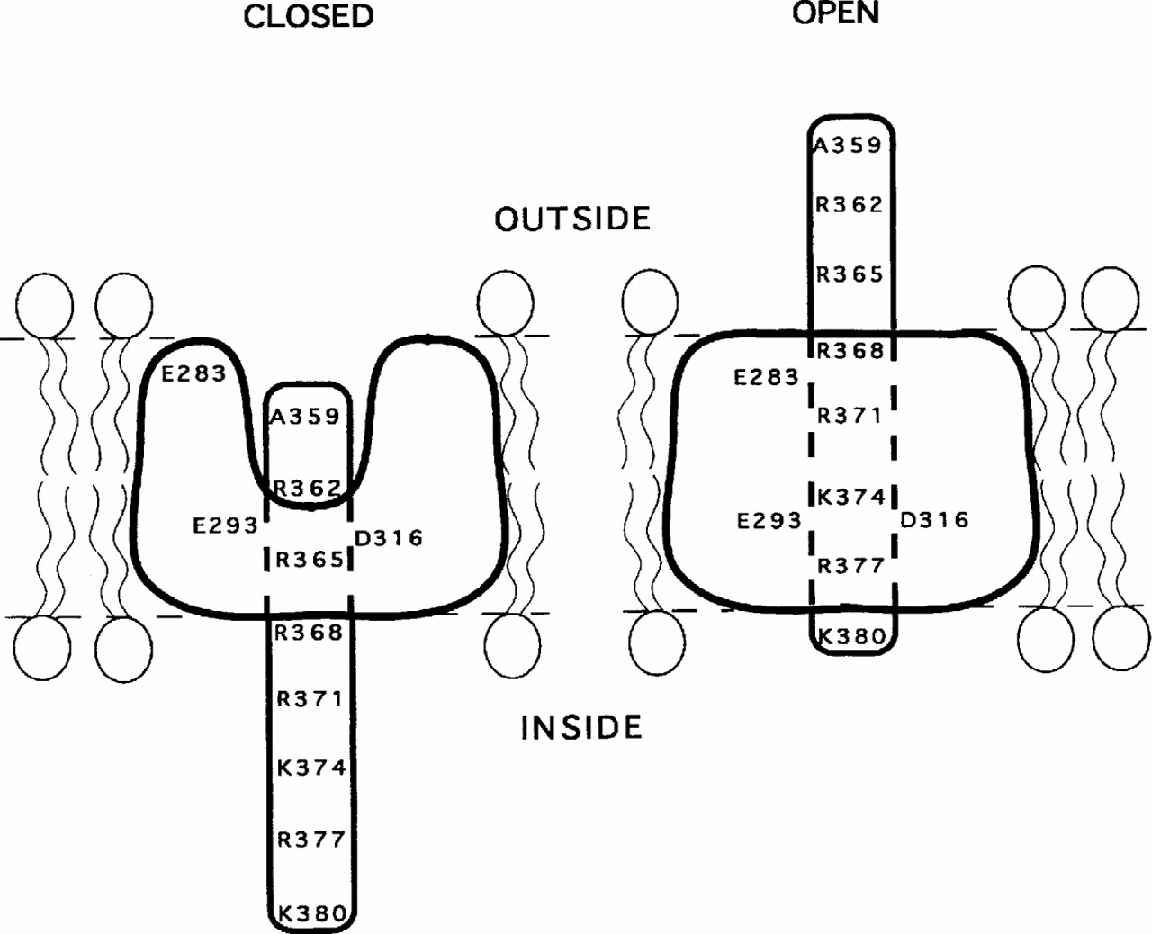
Conclusion: movement of charged residues lining the pore

Slide 35
A voltage-gated ion channel
A
VSD
Pore
B
Selectivity filter
S1
S2
S3
S4
S5
S6
1
+
2
4
3
+
+
+
+
+
+
+
NH₂
COOH
C
Closed
Open
outside
outside
+
+
ΔV
+
+
+
+
+
+
+
+
+
+
+
+
+
+
- - - - -
inside
+ + + + +
inside

Slide 36
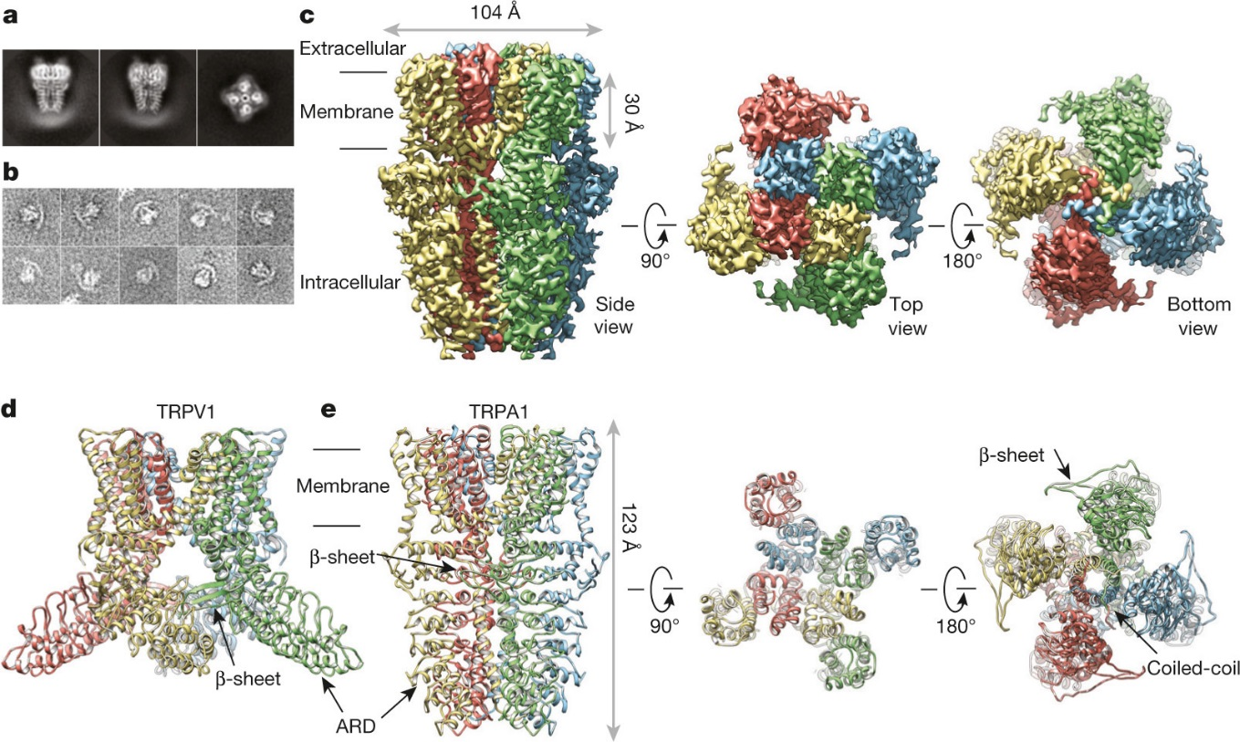
Question: how is functional diversity generated?
TRPA1

Slide 37
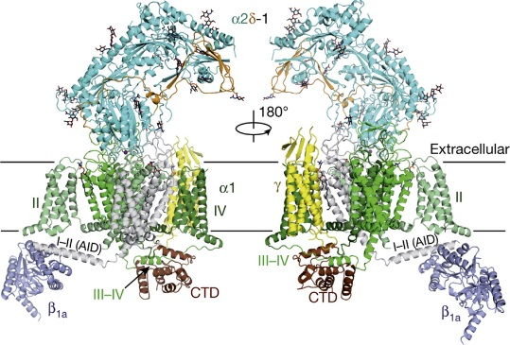
GluA2
CaV1.1
EAG
CNG
Slo2.2
HCN1
Slo2.2
BK
hERG
KCNQ1

